Slide 1
Camera Angle
Notes:
https://www.waferworld.com/wafer-manufacturing-standards-high-quality-wafers/
Innowave picture size = 5120 * 5120

Slide 2
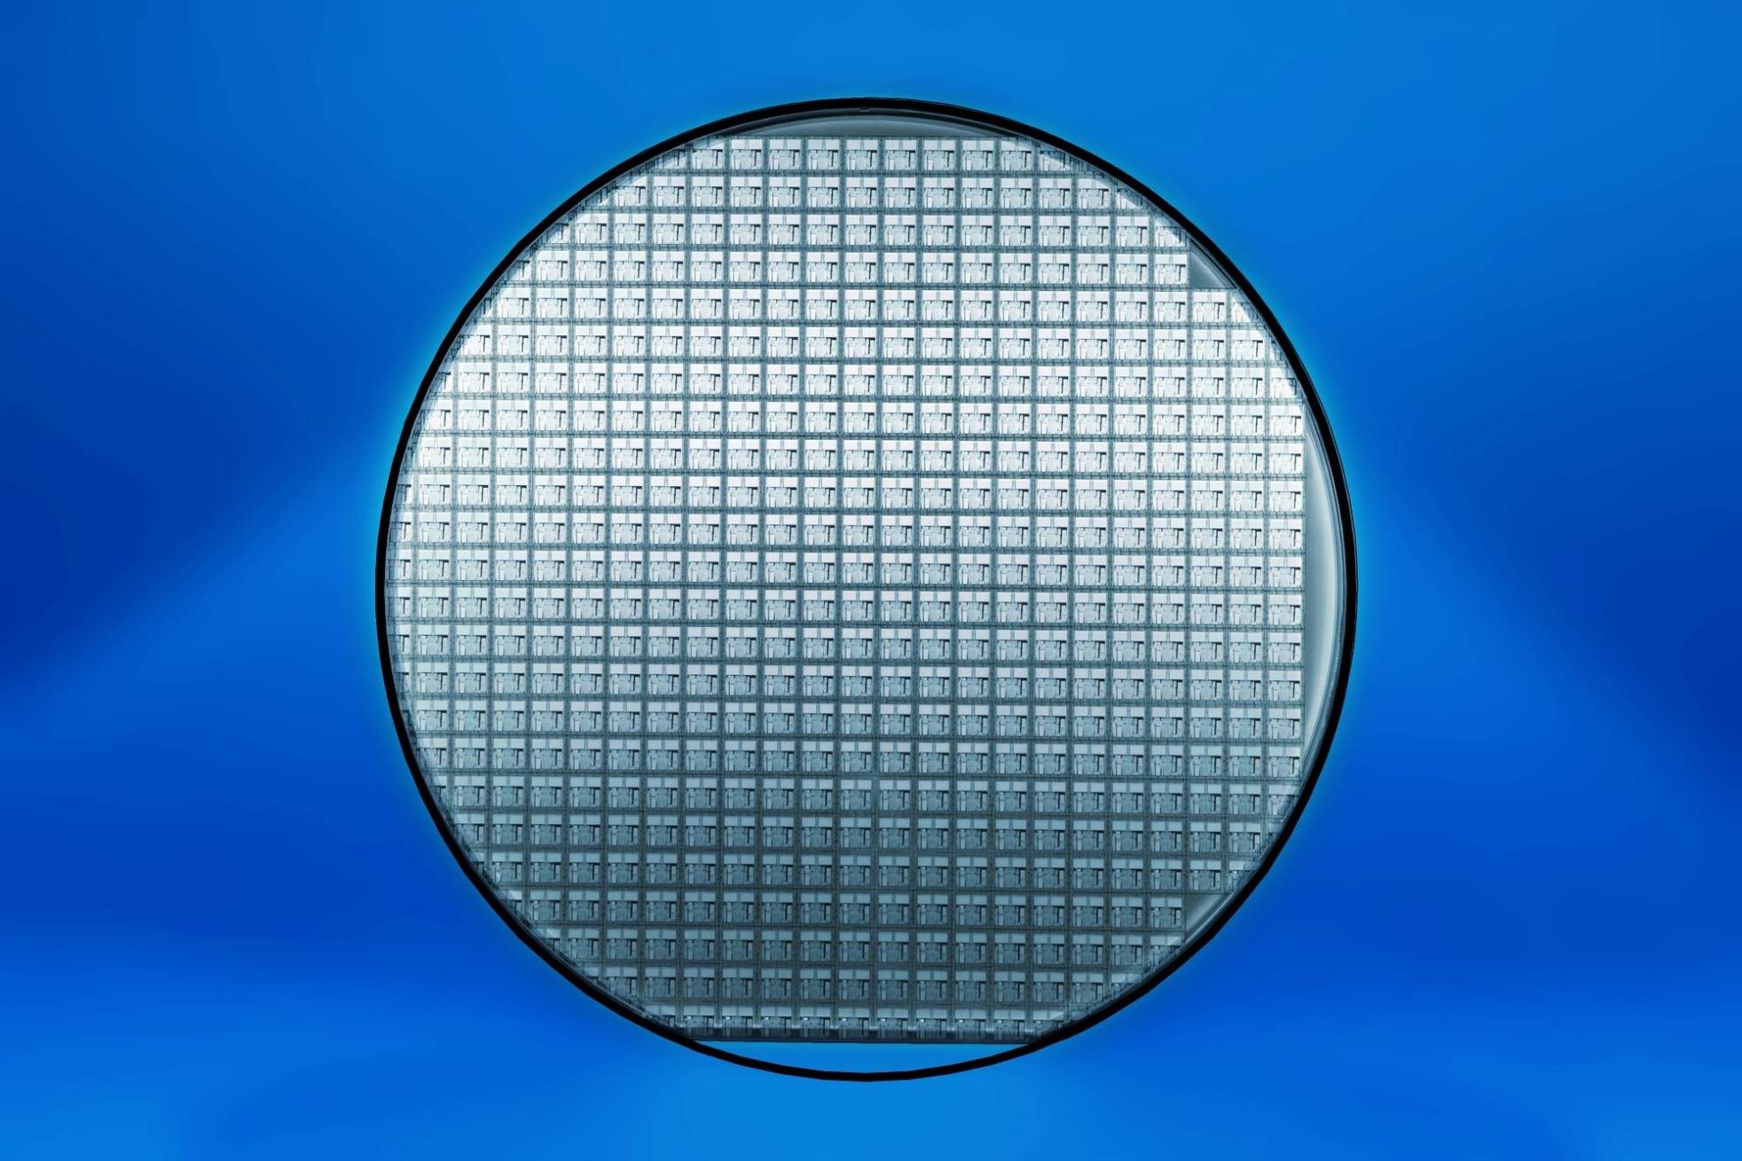
Base Template

Slide 3
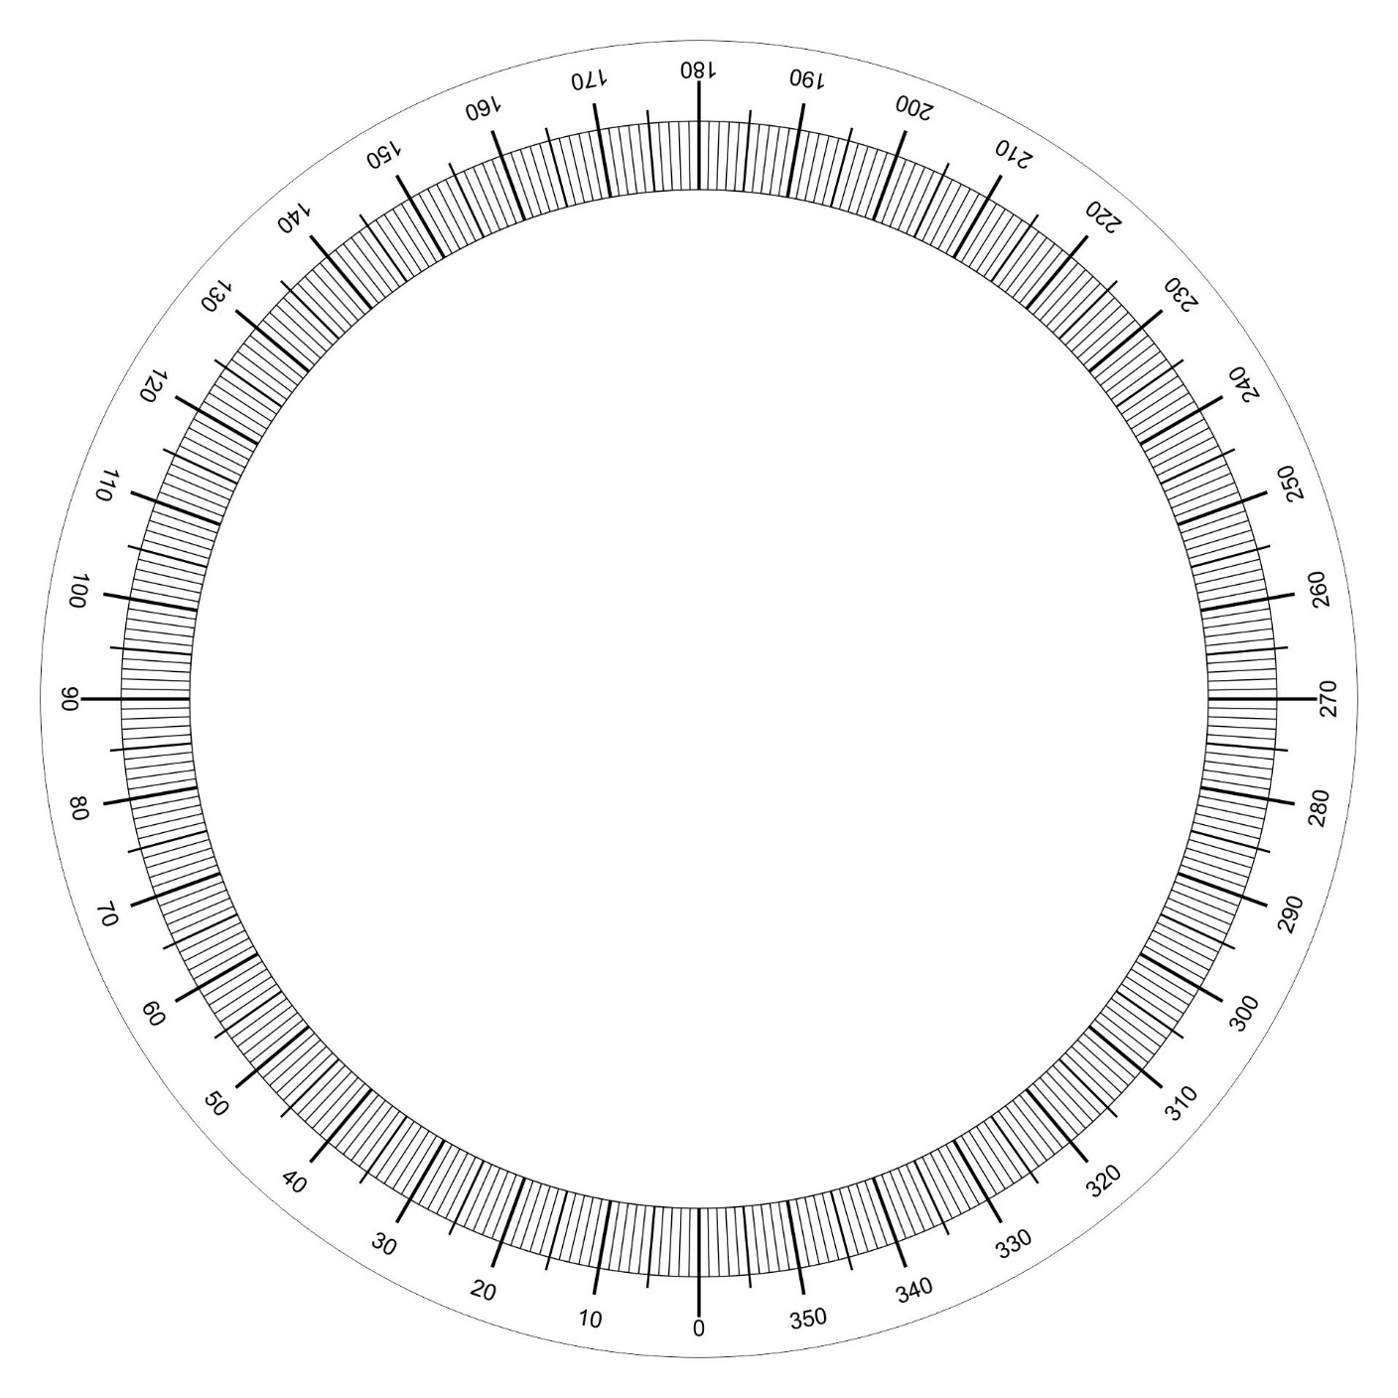
Degree Markings

Slide 4
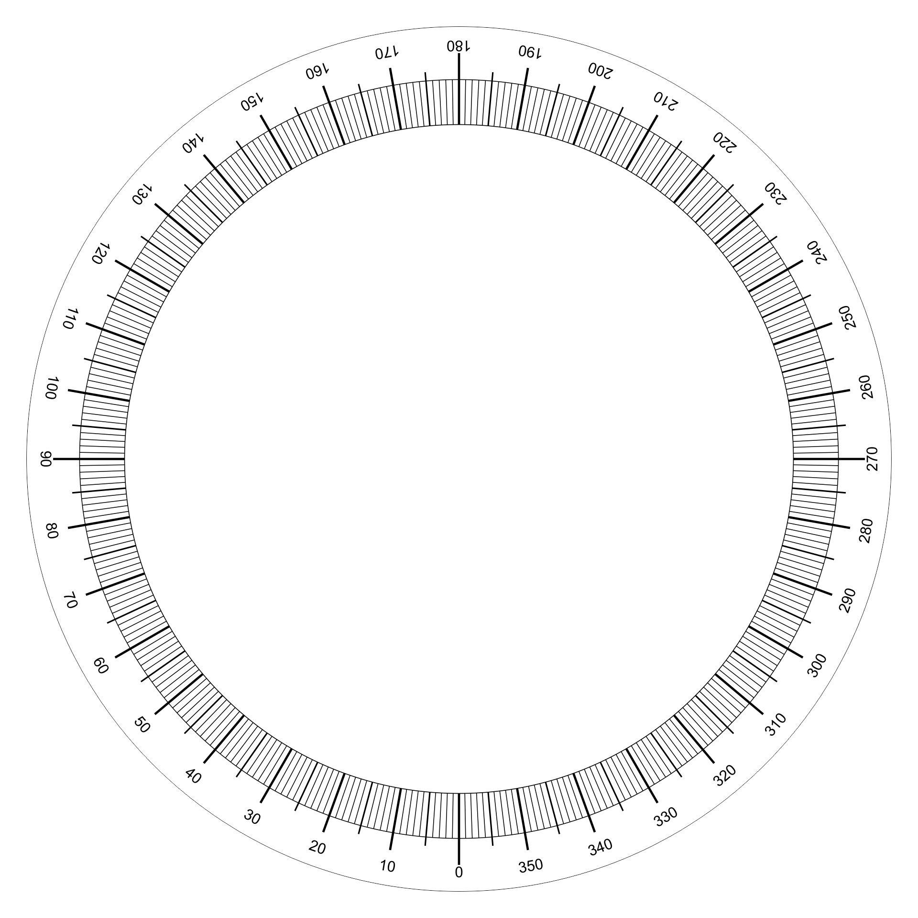
Degree Markings with lines

Slide 5

Degree Markings with lines

Slide 6
Shape Markings

Slide 7
Pattern Markings
T
L
R
B

Slide 8
Overall
T
L
R
B

